Slide 1

CHICAGO CRIME ANALYSIS
Gaurav Singh

Slide 2
PROBLEM STATEMENT
A year ago in Chicago, the high incidence of crime prompted the government to take decisive action by launching an operation with top-performing police officers. Now, as a year has passed since this decision, the government seeks to evaluate the reduction in crime cases and the advantages gained from this new operation.

Slide 3

DATA OVERVIEW
Dataset: Incident records with key attributes like ID, Date, Type, Location, Arrest, Domestic, etc.
Metrics: Incident count, arrest rate, domestic incident rate, location distribution, crime categories.
Exploration: Insights into crime types, locations, and temporal trends.
Quality: Addressing missing values, consistency checks, and validating geographic coordinates.

Slide 4

METHODOLOGY
Data Cleaning: Utilized Power BI Query Editor for data cleaning, ensuring accuracy and consistency.
Column Creation: Employed DAX formulas to create additional columns for enhanced analysis.
Advanced DAX Measures: Developed advanced DAX measures to derive insights and support analytical requirements.
Visual Creation: Utilized Power BI's visualization tools to create intuitive visuals for better understanding and analysis of the data.

Slide 5

ANALYSIS OF OBJECTIVE QUESTIONS
Data Cleaning: Removed null values, created new columns using DAX formulas.
Crime Type Analysis: Theft identified as most prevalent crime.
Arrest Rate Evaluation: Arrest rate found to be 12.42%.
District Crime Distribution Assessment: District 6 had highest number of reported incidents.
Categorical Attributes: Identified several categorical columns in the dataset.
Handling Null Values: Removed null values from X and Y coordinate columns.
Domestic Crime Proportion Analysis: Domestic crimes account for 20.02% of total crimes.
Location Description Analysis: Apartment locations show highest crime frequency.
Average Time to Resolve Cases: Average time to resolve a case is 9.03 days.
Calculated Columns vs. Add Columns: Created calculated columns using DAX formulas and additional columns using Power Query Editor.
Using Calculate and Row Iteration: Calculated number of theft crimes in District 8.
Separating Longitude and Latitude: Used 'Add Column with Example' feature to split longitude and latitude values.
M Language in Power Query: M-query used for data transformation tasks in Power Query Editor.

Slide 6
ANALYSIS OF SUBJECTIVE QUESTIONS
Crime rates fluctuated monthly, with a significant drop in June.
Strategies for crime reduction included policing, community engagement, and addressing root causes.
High-crime areas like Apartment Street need tailored interventions.
Wards 42, 27, 28, 6, and 24 require security enhancements.
Crime rates varied by month and day, suggesting a need for proactive measures.
Arrest rates for domestic crimes were alarmingly low.
Common terms in crime descriptions shed light on prevalent crime types.
Resolution times varied based on crime type and location.
Theft was the most prevalent crime type, followed by battery and criminal damage.
Power BI Gateway enables secure data access and real-time analytics.
A many-to-one relationship exists between districts in crime data and district_ids in a new table.

Slide 7


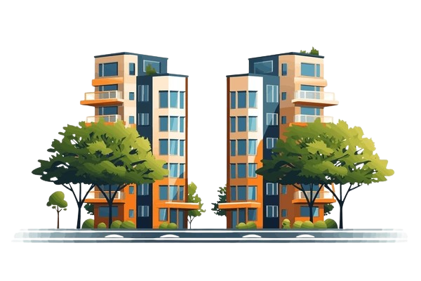


19766
IMPORTANT ANALYSIS
511
19,353
Theft Crime
Month may
Key insights from the data theft crimes are predominant, May has a spike in crime occurrences, apartments register a large number of cases, especially domestic incidents, with a lower arrest rate.
14,768
18,002
12.42%
Apartment location type
Domestice crime
Arrest Rate

Slide 8
PROBLEM SOLUTION
Over the past year, Chicago's government has embarked on a concerted effort to address the city's persistent crime issues by deploying top-performing police officers in a decisive operation. Now, as we evaluate the outcomes of this initiative, our analysis delves into various facets of crime data to gauge its impact and identify areas for improvement. Through meticulous examination, we've uncovered intriguing insights into crime trends, such as the notable increase in crime rates until May followed by a significant decline in June, signaling potential fluctuations that warrant further investigation. Our findings underscore the importance of a nuanced approach to crime reduction, emphasizing strategic interventions tailored to specific crime types and localities. Notably, theft emerges as a prevalent concern, calling for targeted measures to mitigate its occurrence and enhance arrest rates. Moreover, our analysis sheds light on the disparities in arrest rates for domestic crimes, highlighting challenges in addressing this complex issue effectively. By leveraging these insights, we aim to inform evidence-based strategies that prioritize public safety and drive meaningful progress in reducing crime rates across Chicago.

Slide 9
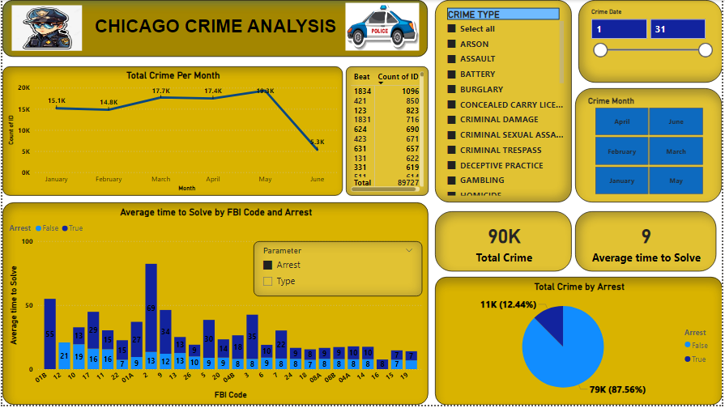
MAIN TAB

Slide 10
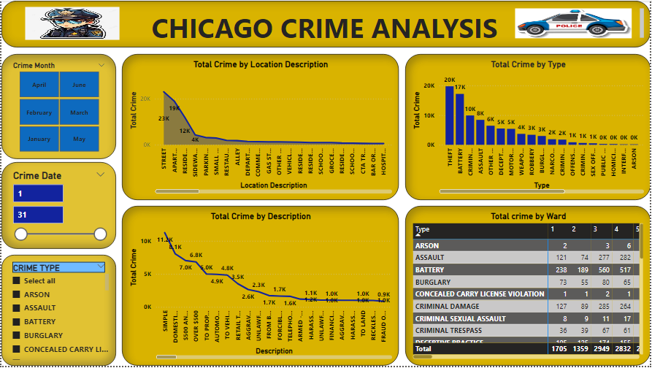
LOCALITY TAB

Slide 11
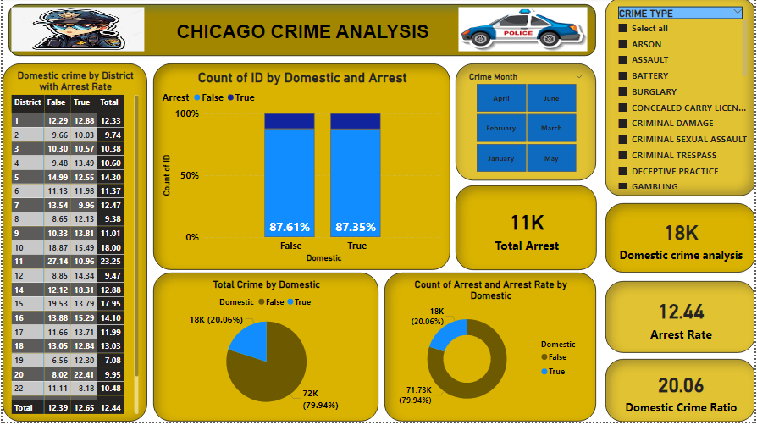
EXPLORATION TAB

Slide 12
THANK YOU

